Slide 1
Connectionism and Bilingualism: Some Simulations of the Order of Learning Effect
Presented at Psycholinguistics Short
University of Ottawa
2003
Ahmad Sohrabi
Carleton University
Cognitive Science Program
asohrabi@connect.carleton.ca

Slide 2
Introduction
For the sake of shortness, connectionist models can be classified as follows:
Simple connectionist models which have single-module and bottom-Up processes.
Complex connectionist models which have multi-module with the interactions between bottom-up and top-down processes.

Slide 3
In this study a common simple model, MLFF, is used to show the general principles of a quasi-regular domain, word naming, which is acquired through a long term experience.
The aim of his study is to generalize the effect of age of acquisition to the second language learning in terms of the order in which two languages are learned.
The second language is subject to the effect of the order of learning that is ,other factors being equal, compared to L1, L2 needs more exposure to be learned.
First come, First served?

Slide 4
McClelland et al (1995) simulated the graded improvement of children's lexicon. Using a network devised by Rumelhart and Todd (1993) that was trained to reproduce the correct semantic propositions for a small set of concepts (trees, flowers, birds and fish), McClelland et al (1995) examined the consequences of introducing a novel concept (penguin) after the network had been trained.
They did this using either focused or interleaved learning.
With focused learning, new knowledge is presented to the system without interleaving it with old knowledge. Under such conditions, information about penguins was acquired rapidly but at a cost to pre-existing knowledge – known as catastrophic effect.
But with interleaved learning, continuing the exposure to the old material alongside the new, the new information was acquired without cost to the old.

Slide 5
Connectionist model can capture the statistical covariations and correlations between input, representation and output. Word naming or reading single word aloud is learned after several exposures to printed form (orthography) and the relevant sounds or phonology of the words.
It will be a relatively an automatic process gradually, so, in the stroop task can affect the word color naming but the color naming doesn't affect it.
It has also been shown that word naming, like some of other processes, is the subject to the age of acquisition effect that is, the early learned words are read better than later learned words (Barry, Morrison, & Ellis, 1997; Carroll & White, 1973).
And, that, this effect is not due to critical period of language learning as shown in the second language word reading learned after 7 years (Izura and Ellis, In press, Sohrabi, 2002).

Slide 6
The Current Model
A distributed connectionist model based on Rumlhurt and McClelland (1986) was used. [similar to Ellis and Lambon-Ralf (2000) here random patterns, not similar to Sohrabi (2002), which word in primary school's books were used for simulation].
At the start of the training, connections were weighted initially by random values between +0.5 and -0.5. Then the model was trained by error back-propagation algorithm Rumelhart et al, 1986).
Other parameters are as follows: 100 input units, 100 output units, 50 hidden units, learning rate 0.05 without momentum.

Slide 7
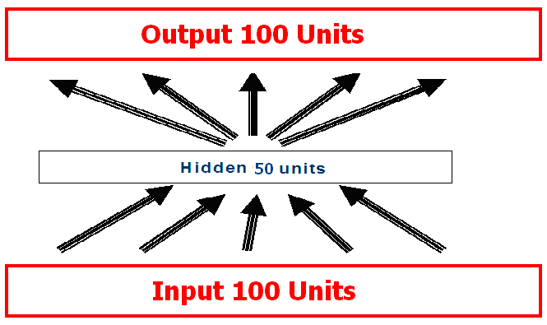
Input patterns were the random binary codes with 20% 1s and 80% 0s. The output patterns produced by changing 10% of bits from 1 to 0 or vice versa. 100 patterns used for L1 and the same number used for L2.

Slide 8
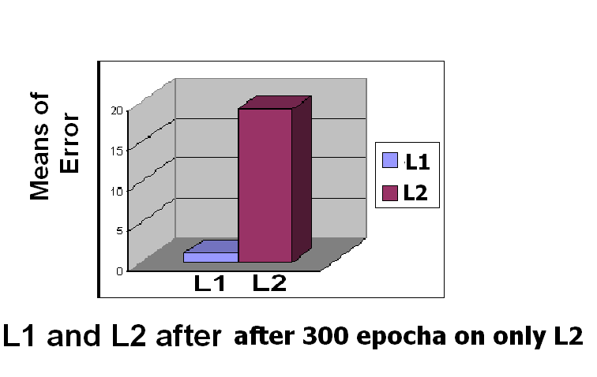
In simulation 1, only L1 were trained for 300 epochs. The model has not been trained on L2 in this moment.

Slide 9
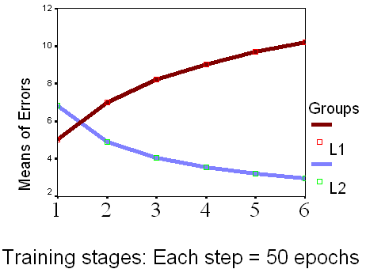
In simulation 2, the trained model of simulation 1 were trained on L2 for another 300 epochs. As a catastrophic effects the learning of L2 destroyed the learning of L1 because L1 has no longer been trained alongside L2.

Slide 10
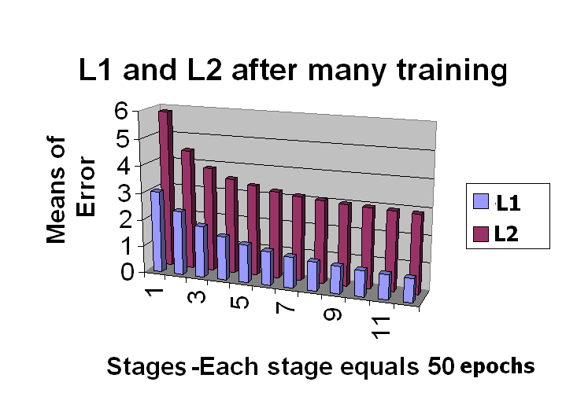
In the last and main simulation, the trained model of simulation 1 was trained on both L1 and L2 for 600 epochs, but with L2 trained more frequently, 1200 sweeps on L2 compared to 600 sweeps on L1. As can be seen L1 keeps its superiority for a long time even with rarely training.

Slide 11
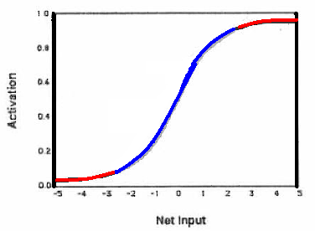
The nonlinear (logistic activation) function that its slope is greatest when its input is around 0, as in start of training while decreases in both positive and negative directions as training proceeds.

Slide 12
Conclusion
The connectionist modeling showed the effect of order explicitly. This effect is due to the loss of plasticity in neural networks trained with error back propagation in which neurons have more capacity to change in the starting of the learning L1 and leave less space for L2 to be learned. The nonlinear activation in these neurons gradually approaches its extreme levels of activation and doesn't change easily in later training.
Thus the order in which language is learned is an important factor and taking it into account in both research and education is the implication of this study.

